Slide 1
Thales alenia space roadmap on passive components (Focus on LEO/MEO Missions)
Spcd 2024 - 5th space passive components days
V. Boutan and C. Guilbert / D. Ducasse
T. Valette ; E. M-Schmidt ; C. Dessaint ; T. Ihorai (TAS-France)
M. Del Pozo Losada ; P-J. Garcia Arribas (TAS-Spain)

Slide 2
tABLE OF CONTENTS
1
LEO/MEO Constellation scenario –
General presentation
5
Qualification-Validation process
2
Specificities of a LEO/MEO mission
6
Supply chain constraints
3
Requirements for passive
components
7
Conclusion
4
COTS and Manufacturers selection

Slide 3
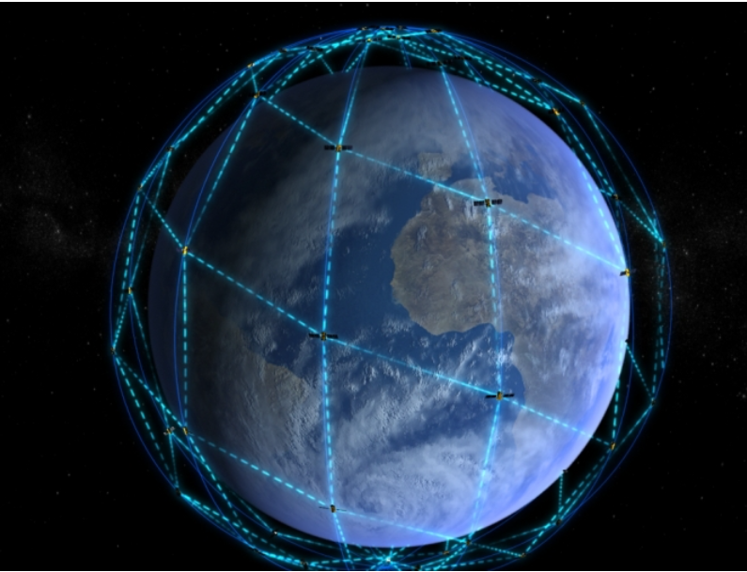
LEO/MEO constellation scenario - general presentation
Constellation scenario can be a multi-orbital solution. It combines the benefits offered by Low Earth Orbit (LEO), Medium Earth Orbit (MEO) , and Geostationary (GEO) satellites.
Thales Alenia Space proposes solutions for all orbital configurations
This presentation is addressing LEO & MEO solutions
Main Hypothesis & Objectives for LEO & MEO :
Maximize the use of disruptive technologies (Commercial and
Automotive components)
Maximize use of open source technologies, open standards and
Interoperability
Ensure SMEs and start-ups participation

Slide 4
Specificities of a LEO/MEO mission
Specificities to consider for a LEO/MEO mission
Radiation (materials) / High number of thermal cycles
Reduced size (integrated solutions), low weight, high performances
High volume of components to procure
Need to reduce the overall cost of the program
Schedule constraints (high quantity of satellites to build in a reduce lead time)
Life time (up to 15 years)
New quality requirements (“next” space and disruptive approach authorized)

Slide 5
Requirements for passive components
RF passive components, RF connectors (up to Ka band), High data rate connectors (up to 25Gbps) and DC connectors (with floating mounting capability)
Reliable interconnection solutions / High density-Integrated solutions / Solderless terminations or SMD terminations for fully automated assembly / Fast locking solutions
Capacitors, resistors, magnetics, ceramic filters
Reliable technologies / dimension-mass-performances / SMD terminations for fully automated assembly (mounting and cleaning compatibility)
→ COTS solutions preferred : AEC-Q200 (when available) / High runners vs High Rel market / Competitive solutions (low cost)

Slide 6
COTS selection
COTS in space applications offers very attractive perspectives in term of performances and competitiveness
COTS shall be selected from major manufacturers (preferably listed in THALES PML)
COTS selection based on TAS heritage and THALES PPL
COTS shall be selected to withstand all environmental conditions :
Handling and storage,
Mounting processes and ground testing,
Launch and space environments
Selected COTS shall meet operation stability, safety, long term reliability and tolerance to radiation exposure defined for the duration of the mission
→ Targeted qualification system : AEC-Q200 (when existing) or equivalent

Slide 7
manufacturers selection
Selected manufacturers shall demonstrate :
The will to deliver components for space applications
The capacity to manufacture high volume
The possibility to deliver customer needs from a single manufacturing plant
An existing product assurance program with the following items :
An effective system for process characterization / control and product qualification
A reliability test program for generating reliability data for processes / products
A manufacturing line under Statistical Survey (SPC)
An effective policy ensuring continuous process improvement
A responsive behavior for application and failures related issues
A web-site with updated data-sheet, application notes, PCNs, PDNs, alerts, errata sheets, technical support
A responsive behavior, accepting audits/visits in their production sites

Slide 8
Qualification/validation process
The product Qualification/Validation shall be supported by :
Product Qualification data from manufacturer or THALES/TAS to improve confidence (PPAP, reliability data)
Additional validation tests + derisking tests (to check the compatibility with user mounting processes)
Construction analysis (including CTE analysis if needed) on several lots to evaluate the manufacturing reproducibility and to check the changes in materials/process
An Audit of the manufacturing location to consolidate the procurement approach
Mounting qualification

Slide 9
Supply Chain constraints (1/2)
Procurement/usage of low cost components (COTS/Automotive) with a suitable reliability level is mandatory
Management and qualification of new procurement sources with the following risks :
No experience on space / no heritage
Delivery of parts from different manufacturing locations (US, Asia,…) with different quality level
Misunderstanding : difficulties to get clear information from the manufacturer – confidence in the communication
Need to freeze with the manufacturer the manufacturing location (if possible) in order to reduce the risk of changes in materials/process
Manufacturer to deliver lower volume compared to their mass production (resistors, capacitors…)
Need to implement PCN/PDN/Errata sheets survey

Slide 10
Supply Chain constraints (2/2)
Single lot or at least to consider a continuous production in a period of time
Huge quantities by minimizing the number of manufacturer lots (Connectors, RF Passif, Magnetics…)
→ reduction of lot validation (Construction Analysis/Lot Acceptance Tests)
Need to perform periodic construction analysis and/or CTE analysis (if applicable) to supervise the changes in materials/process
Need to perform a visual inspection by sampling at receipt (in some specific cases/families)

Slide 11
Conclusion
Space market adaptation : from HiRel to “next” space
TAS LEO/MEO Roadmap : No compromise on reliability and performances for integrated and industrialized solutions
Disruptive approach : Manufacturer/Component selection - Evaluation/Qualification/Usage
Think different

